Slide 1

IRONHACK
The secrets to achieving more and suffering less
Notes:
Hello Ironhacker and welcome to this workshop on Understanding Emotions in the Bootcamp Journey and beyond. My name is Clara Pinillos, and I am excited to be here with all of you today. As we all know, learning to code, design, or prepare for a job interview can be an exciting, yet challenging journey.
In this workshop, we will explore the role of emotions in this journey and learn how to navigate them in a healthy and productive way.
By the end of this session, you will have a better understanding of what emotions are, how they impact your thoughts and behaviors, and practical tools to manage them effectively. So, let's dive in and explore this fascinating world.

Slide 2

E-Motion from its original root movere
Emotions make us act
Notes:
As you all know, the bootcamp experience can be intense and emotionally challenging. We understand that you might experience a range of emotions throughout the journey, including both positive and negative ones. For example, when you are able to complete a difficult coding task successfully, you might feel a sense of pride and accomplishment.
Or if you struggle with one of your labs and an fellow Ironhacker offers to help out, you might feel grateful and happy.
On the other hand you’re having difficulty understanding a new concept, you might feel frustrated and discouraged.
But remember it's okay to feel negative emotions sometimes, in fact they are almost necessary and definitely part of the journey, because they will also push you to keep learning and fighting to slowly but surely become the new person and tech professional you want.
We want to acknowledge and appreciate your incredible courage for embarking on this journey and we want you to know that you are not alone and that you will supported throughout your bootcamp and beyond, not only by your Lead Teachers and TA’s, but also by your Program Managers, classroom colleagues and of course, your Student Success Managers.

Slide 3
Emotions and their purpose
IRONHACK 2023. ALL RIGHTS RESERVED.
Notes:
Let’s talk dig deeper into what emotions are and why they even exist if, because - alongside our cognitive abilities, language skills, and advanced technology, emotions contribute to our intelligence and evolution as a species.

Slide 4

Emotion is how we feel when something happens to us or around us.
It makes us think, feel, and do something.
Emotions can be triggered by things outside (external) or inside (internal) us.
Every emotion has a reason for us to feel it.
Emotions send messages to the brain in order for us to react in a certain way.
Notes:
An emotion is a natural and automatic response from our bodies to an internal or external trigger that influences our thoughts, feelings, and actions.
External triggers can include things like an unexpected event or a particular situation, while internal triggers can stem from our thoughts or memories.
For example, if you receive a compliment from someone you admire, you might feel a surge of happiness as an external trigger. The same way you might feel a sudden rush of anxiety, panic, or even helplessness if you lose a personal item such as a phone or a wallet. Internally, you might feel a twinge of sadness if you think about a past relationship that didn't work out or a sense of pride if you recall a significant accomplishment.
All emotions (positive and negative ones) are an essential part of the human experience that help us distinguish between dangerous or pleasant situations to alert us to take certain measures. Think of them as a sort of thermometer for the mind and body, indicating whether we need to change, adapt, or learn something new to better navigate the world around us.
For example, fear protects us from danger, while happiness connects us to situations and communities. For instance, if we didn't feel fear when crossing a busy street, we might not look both ways and could get hit by a car. And if you didn't feel happiness when learning how to code during the bootcamp, it could be difficult for you to stay motivated and continue to put in the effort required to learn and progress.

Slide 5


Normal negative emotions during and after the bootcamp
Fear: It's natural to feel afraid when facing a new challenge.
Frustration: You may find yourself feeling frustrated when you encounter an error in your code or not passing interviews.
Low self-esteem: It's common to doubt your abilities and feel inadequate.
Stress and Anxiety: The intensity of the bootcamp and/or the job hunt can be stressful and may cause you to feel anxious.
Imposter Syndrome: You might question whether you belong in the bootcamp, deserve graduating and feel like a fraud.
Notes:
During the bootcamp, it's normal to experience a range of emotions, including negative ones. Think about it, you probably come from a completely different background, never worked with a spreadsheet before, imagined you would be coding with React and so on. Plus you may have moved from another country and are still adapting to the culture, have a family to take care of, and so on. And still, here you are sooo brave challenging yourself every single day and working hard to do this bootcamp. Let’s see some of these emotions you might already be going through or perhaps will in the coming future.
Fear:First of all, we all feel afraid when facing a new challenge. But the more we get exposed to it, the more that fear dissipates. Frustration: You may find yourself feeling frustrated when you encounter an error in your code that you can't seem to fix whilst working on one of your projects, or very upset when you don't understand a concept right away. Well, who wouldn’t?
Low self-esteem: It's common to doubt your abilities and feel inadequate, especially if you're comparing yourself to others in the bootcamp who seem to be progressing faster or doing better than you. Remember, that every person has a different journey, not better or worse, just different.
Stress and Anxiety: The intensity of the bootcamp can be stressful and may cause you to feel anxious, particularly if you're feeling overwhelmed or falling behind - also because of some of the examples mentioned above (living in a different country, having to take care of your kids or being in a difficult economic situation)
Imposter syndrome: By now, you may have heard of this term, and if not, don’t worry because there will be a separate workshop on it. The point is that you might question whether you belong in the bootcamp, whether you deserved to be graduating and feel like a fraud, especially if you don't have much experience in coding or designing. Well, according to a study conducted by the International Journal of Behavioral Science, an estimated 70% of people experience Imposter Syndrome at some point in their lives. More so, if they’re thrown out of their comfort zone - like you are, Ironhacker! So as you can see, this happens more often than not.
Once again, it's okay to feel negative emotions sometimes. In fact, feeling them can be a sign that you're challenging yourself and going the extra mile. These emotions can actually push you to become better by motivating you to work harder and improve. However, it's important to manage these emotions effectively so that they don't become overwhelm and hinder your progress. So, don't be too hard on yourself and know that you're not alone. We're all in this together and we'll support each other throughout the bootcamp.
Now let’s talk about resources to help you manage these better!

Slide 6

Imposter Syndrome
An intense feeling that achievements are undeserved and the sensation to be discovered as fraud.
FEAR not fear of failure but fear of being discovered.
DOUBTS about your capacity to do things you are prepared for
FALSE BELIEFS of not deserving the success of your own accomplishments
PERMANENT INSATISFACTION other challenge or goal with erase this feeling
Notes:
During the bootcamp, it's normal to experience a range of emotions, including negative ones. Think about it, you probably come from a completely different background, never worked with a spreadsheet before, imagined you would be coding with React and so on. Plus you may have moved from another country and are still adapting to the culture, have a family to take care of, and so on. And still, here you are sooo brave challenging yourself every single day and working hard to do this bootcamp. Let’s see some of these emotions you might already be going through or perhaps will in the coming future.
Fear:First of all, we all feel afraid when facing a new challenge. But the more we get exposed to it, the more that fear dissipates. Frustration: You may find yourself feeling frustrated when you encounter an error in your code that you can't seem to fix whilst working on one of your projects, or very upset when you don't understand a concept right away. Well, who wouldn’t?
Low self-esteem: It's common to doubt your abilities and feel inadequate, especially if you're comparing yourself to others in the bootcamp who seem to be progressing faster or doing better than you. Remember, that every person has a different journey, not better or worse, just different.
Stress and Anxiety: The intensity of the bootcamp can be stressful and may cause you to feel anxious, particularly if you're feeling overwhelmed or falling behind - also because of some of the examples mentioned above (living in a different country, having to take care of your kids or being in a difficult economic situation)
Imposter syndrome: By now, you may have heard of this term, and if not, don’t worry because there will be a separate workshop on it. The point is that you might question whether you belong in the bootcamp, whether you deserved to be graduating and feel like a fraud, especially if you don't have much experience in coding or designing. Well, according to a study conducted by the International Journal of Behavioral Science, an estimated 70% of people experience Imposter Syndrome at some point in their lives. More so, if they’re thrown out of their comfort zone - like you are, Ironhacker! So as you can see, this happens more often than not.
Once again, it's okay to feel negative emotions sometimes. In fact, feeling them can be a sign that you're challenging yourself and going the extra mile. These emotions can actually push you to become better by motivating you to work harder and improve. However, it's important to manage these emotions effectively so that they don't become overwhelm and hinder your progress. So, don't be too hard on yourself and know that you're not alone. We're all in this together and we'll support each other throughout the bootcamp.
Now let’s talk about resources to help you manage these better!

Slide 7


CONSEQUENCES
Aside from all the physiological reactions that we mentioned earlier, there are clear behavioural consequences of experiencing Imposter Syndrome
ANXIETY feelings and constant suffering
INABILITY TO ENJOY the achieved milestones and the present moment
WORK PERFORMANCE
PERMANENT INSATISFACTION thinking you should have done better
Notes:
First of all, Self-awareness: it is the ability to recognize and understand our emotions and how they affect our behavior.
One way to develop self-awareness is by keeping a journal to help track emotional responses to different situations. By writing down your thoughts and feelings, you can identify patterns and triggers that can help you better understand your emotional responses. Just take 5 minutes at the end of each day and write down how you’ve felt today.
Another way to develop self-awareness is by talking to someone you trust, such as your Ironhack partner (for example you PM during the bootcamp or SSM during the job search), and share with them how you feel. This is our job, to make this journey as smooth as possible for you. We will always be there to offer a different perspective and help you gain more insight into your emotions.
Remember, developing self-awareness takes time and practice. By reflecting on your emotions and seeking feedback from others, you can increase your self-awareness and better understand yourself and your emotions.

Slide 8
How to deal with emotions during and after the bootcamp
IRONHACK 2023. ALL RIGHTS RESERVED.
Notes:
Emotional Intelligence refers to the ability to recognize and understand our own emotions and the emotions of others, and to use this information to guide our thoughts and actions in a positive way. Developing tools & resources to deal with difficult emotions during the bootcamp and later in your job hunt involves a combination of skills that we will now cover and that you can start practicing today.

Slide 9
The Dichotomy of Control & The Circle of Influence
IRONHACK 2023. ALL RIGHTS RESERVED.
Notes:
Hopefully the Serenity Prayer sounds somewhat familiar to you, this goes: God, grant me the serenity to accept the things I cannot change, courage to change the things I can,
and wisdom to know the difference. This means that of the most important things to learn in life is that our wellbeing should never depend on things that are out of our control - but rather on our own actions, perceptions and attitude. This will contribute to more success and less suffering in life and ties in perfectly with a strategy that you can very well apply to the bootcamp, to the job hunt later on and really, anytime in life.

Slide 10
Here goes A title
Other’s opinion
Area of Concern
Things that are out of your control
Global pandemic
Your habits
Your communication skills
Weather
Area of Influence
Things that are within
your control
Your mindset
Your attitude
Economy
Political unrest
Notes:
We’d like to to introduce you to the Dichotomy of Control, again a philosophy that teaches us to focus on what's within our control and let go of what's not. In other words, it's about understanding the difference between what we can change and what we can't, and directing our energy and attention towards what we can change.
One way to visualize the Dichotomy of Control is by using the Circle of Influence. This is a concept developed by Stephen Covey, author of the book "The 7 Habits of Highly Effective People." The Circle of Influence, the inner one. The outer side of the circle is the Circle of Concern, which represents things that we don't have control over, such as the opinions of others, the weather or the economy. Now, let’s try to find examples of challenges that can appear during the bootcamp of after and put them in perspective by categorising them in our area or the other.

Slide 11
Here goes A title
The quality/technologies taught in the bootcamp
Market conditions
Area of Concern 🤕🪫
Things that are out of your control
Number of applicants for a job
Practice and build projects
Your time management
Build a strong online portfolio
Area of Influence 🦸‍♀️🔋
Things that are within
your control
Network with industry professionals
Other classmate’s progress
Seek help from Seniors or SSM
Applying for jobs
The pace of the bootcamp
Prepare & practice interviews
The outcome of the bootcamp/ job hunt
The hiring manager’s decision-making process
Notes:
In this slide you will see examples within the Circle of Concern and Circle of Influence for you Ironhacker, while undergoing your bootcamp or while looking for your first job in tech afterwards. The Circle of Concern includes things that are outside of our control, such as the overall job market conditions, the technologies taught during the bootcamp, the number of applicants for a specific job opening you’re applying to, the actual outcome of the bootcamp itself or that of the job hunt - that’s something in the future - and you cannot control future - you can only do your best to perform and prepare for it. The hiring manager's decision to choose another candidate for a job vacancy is also out of your control - you can only ask for feedback, accept it and continue learning and practicing to do better next time, the salary range for entry-level positions in the industry and in your city, that’s also regulated by the market and things that are out of your control, the pace of the bootcamp, intense and greatly challenging - it is what is it. You can only ask for help and seek resources and tools to make you deal with it better day by day. The list in this region of the circle of concern can be endless.
But on the other hand, the Circle of Influence includes things that are within your control, such as improving coding skills by practicing and building projects, networking with professionals in the industry and attending events, following your Ironhack SSM’s advice, building a strong online portfolio and personal brand, prepare for job interviews and practicing common interview questions, seeking mentorship or guidance from senior developers or instructors, and proactively applying for job openings and following up with potential employers, make sure you follow a strategy to keep yourself motivated and in focus, etc.
As you can see, putting too much attention on the circle of concern, which represents things outside of your control, will lead you to feelings of helplessness, frustration, and anxiety, as we focus on things that are hardly changeable by ourselves directly. The circle of influence will teach you to focus on what you can control, such as your thoughts (for example, telling yourself that you are just starting, that this is all super new to you and that you simply need a bit more time or help), your feelings, and actions, and directs your energy and attention towards what you can change therefore increasing your chances of success in the job market and as a tech professional.

Slide 12
How to deal with overwhelming emotions
IRONHACK 2023. ALL RIGHTS RESERVED.
Notes:
Emotional Intelligence refers to the ability to recognize and understand our own emotions and the emotions of others, and to use this information to guide our thoughts and actions in a positive way. Developing tools & resources to deal with difficult emotions during the bootcamp and later in your job hunt involves a combination of skills that we will now cover and that you can start practicing today.

Slide 13
SELF AWARENESS
Self-awareness involves reflecting on your emotions and their impact on your behavior.
Be aware of your own thoughts
Keep a journal to help track emotional responses to different situations.
Identifying patterns and triggers can help with self-awareness.
Talk to your Ironhack partner (PM or SSM) or someone you trust
Notes:
First of all, Self-awareness: it is the ability to recognize and understand our emotions and how they affect our behavior.
One way to develop self-awareness is by keeping a journal to help track emotional responses to different situations. By writing down your thoughts and feelings, you can identify patterns and triggers that can help you better understand your emotional responses. Just take 5 minutes at the end of each day and write down how you’ve felt today.
Another way to develop self-awareness is by talking to someone you trust, such as your Ironhack partner (for example you PM during the bootcamp or SSM during the job search), and share with them how you feel. This is our job, to make this journey as smooth as possible for you. We will always be there to offer a different perspective and help you gain more insight into your emotions.
Remember, developing self-awareness takes time and practice. By reflecting on your emotions and seeking feedback from others, you can increase your self-awareness and better understand yourself and your emotions.

Slide 14

SELF-REGULATION:
Practice self-care activities, such as meditation, deep breathing, or any physical exercise to help manage stress and emotions.
When faced with a challenging situation, take a few deep breaths to calm down.
Try to respond calmly and thoughtfully rather than reacting impulsively.
Notes:
Self-regulation is another resource that helps you when you’re struggling and need to manage your emotions in challenging situations, let’s say feeling overwhelmed or stressed. By practicing these techniques, you can improve your ability to manage your emotions and respond effectively in challenging situations.
Practice self-care activities such as meditation, deep breathing, yoga or exercise.
In fact, studies have shown that regular meditation can lower levels of the stress hormone cortisol and reduce symptoms of anxiety and depression. Similarly, regular exercise has been shown to decrease stress and improve mood by releasing endorphins, the body's natural "feel-good" chemicals. Additionally, exercise can improve sleep quality, which can also have a positive impact on your emotional well-being and make you take on challenges during or after the bootcamp with a much better attitude!
When faced with a challenging situation, take a few deep breaths to calm down.
It can help calm down the body's stress response and regulate the nervous system, helping you to deal with anything with greater clarity and emotional regulation, rather than reacting impulsively or out of anger or frustration. Deep breathing can also increase the supply of oxygen to the brain, improving cognitive function and helping to reduce anxiety and stress levels.
Try to respond calmly and thoughtfully rather than reacting impulsively.
Take a moment to pause and breathe deeply before responding or acting
Listen actively to the other person's perspective and try to understand their point of view.
If needed, take some time to think things over and come back to the task later when you feel more composed. Remember that you can always count on your Ironhack fellows to support you in every step of the way.

Slide 15
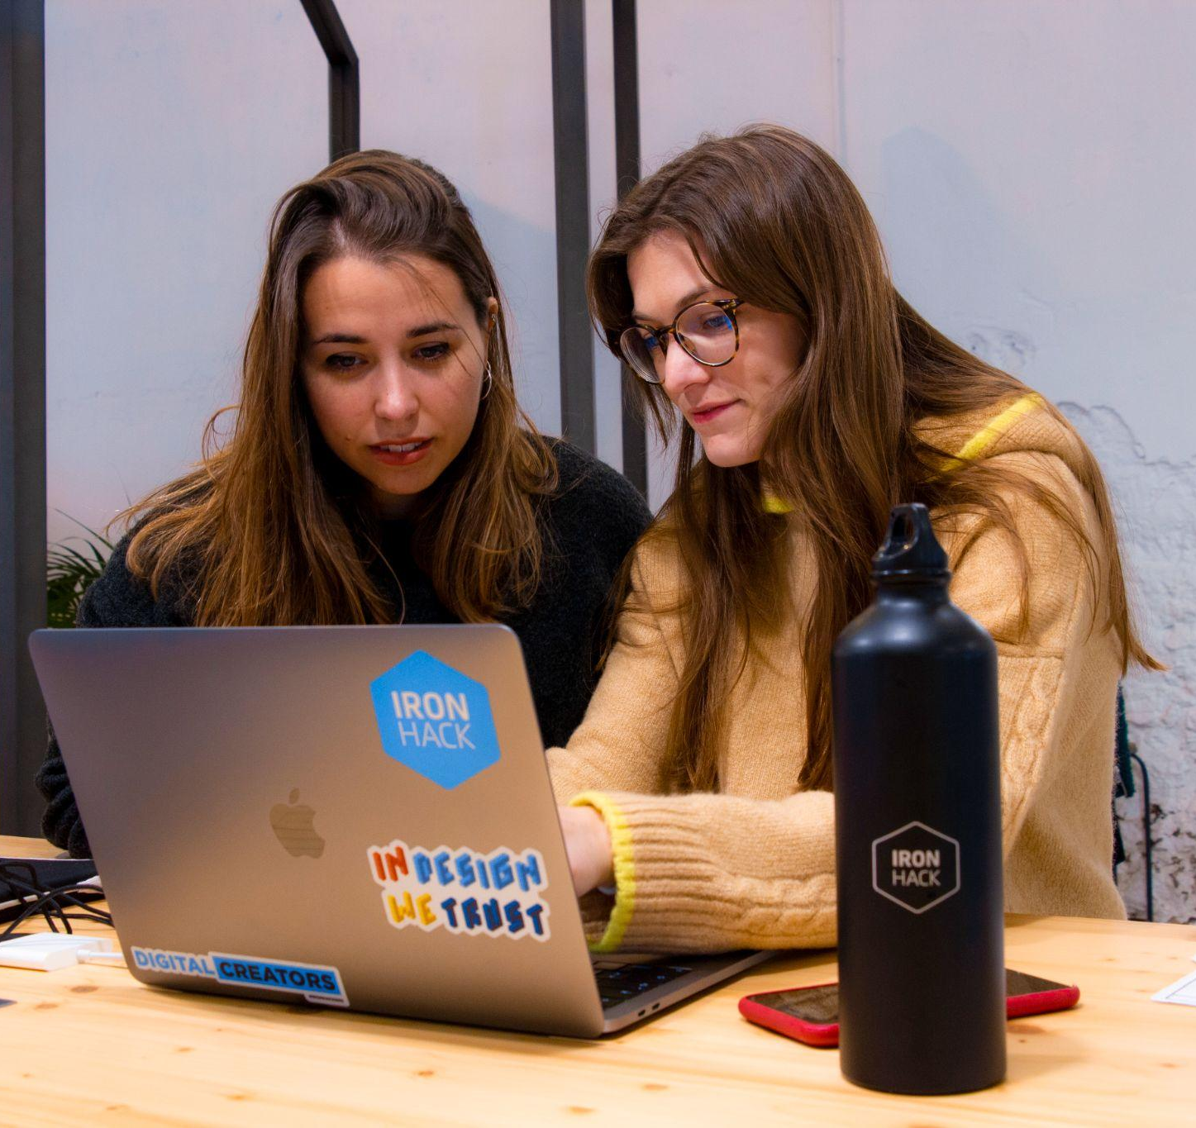
COMMUNICATION
Sharing how you feel takes off a big weight off of your shoulders.
Talk to others and you’ll immediately feel better/understood and supported.
Find a mentor who’s been through the same as you / therapy if needed.
Notes:
Sometimes we feel impacted by how others think or act in a particular situation, making us feel upset, stressed or frustrated. Social awareness is the ability to understand and pick up on the emotions, needs, and perspectives of others, for example your bootcamp classmates or your colleagues at work, and to use that understanding to interact effectively with them. It is an important component of emotional intelligence that will help you build positive relationships with others.

Slide 16

HAVE A PLAN
Instead of procrastinating and being all over the place, be organised and have a plan.
Work in sprints a.k.a. smaller goals/milestones
Review your plan regularly and appreciate the small achievements
Iterate to make it better every time
Notes:
Relationship management is an important component of emotional intelligence. It involves developing strategies and techniques to effectively communicate with others and build positive relationships. If you have poor relationships with your classmates it can not only bring a negative work environment, but it can also create a decrease in your own productivity and that of others. If you struggle to communicate effectively, it can lead to misunderstandings and delays in completing projects or assignments. Also, by not fostering good, healthy relationships with your colleagues, you might be missing opportunities for collaboration, networking and professional development in the future. Same way that if you behave unprofessionally or unethically with a recruiter or a company, you will cut ties for professional synergies in the future. So remember,
Practice effective communication: This means, practice active, careful listening, ask open-ended questions, and seeking to understand the different perspectives from the people you have around you. There’s never one single solution and this technique can not only avoid misunderstandings, but help you build stronger relationships with your colleagues and enrich your own learning.
Conflict resolution: When conflicts arise, it's important to address them in a constructive and respectful way. If something like this happens during the bootcamp, try to find common ground and work towards a solution that is mutually beneficial. Remember, listen actively, ask open questions and be open to understand different perspective - avoiding aggressive or defensive language, and focusing on resolving the issue at hand.
Lasty, Building positive relationships: Offer support and show appreciation for your colleagues' contributions. This can help build trust and foster a positive working environment. After the bootcamp, continue collaborating with others on projects and seek out opportunities to work together to achieve common goals.

Slide 17
Thanks!
IRONHACK 2023. ALL RIGHTS RESERVED.
Notes:
Thank you so much for listening! We hope these resources have been helpful in reminding you that emotions are not only normal, but biologically important! Both the good and the not-so-good emotions. And hey, we all know that bootcamp can be a rollercoaster ride of nerves, frustration, and maybe even a little bit of fear - but that's okay! It's all part of the journey that will help you build your dream career and the personal and professional you want out of yourself. Just remember to take a breather and reach out to your Ironhack Student Success Manager or a trusted person if you need a helping hand. And don't forget to celebrate all the amazing things you are accomplishing along the way! One step at a time. So here's to embracing emotions and enjoying the ride. Cheers!

